Slide 1
In-band Network Telemetry (INT) on Software Switch Programmed by P4
Topology change for existing INT over p4 system
setTopo4UI.py
Instructor: Itzik Ashkenazi
Students: Yamit Barshatz, Shahar Schneor

Slide 2
Background
In-band Network Telemetry (INT) is a new framework designed to allow the collection and reporting of network state, by the data plane, without requiring intervention of additional control plane protocols. Data packets are instrumented with INT header fields that contain “Telemetry Instructions” to INT-capable network device. The instructions tell the devices what Telemetry data to collect and the collected data is written into the forwarded data packets.
INT data that can be collected includes: switch IDs, Input/Output Port IDs, Hop Latency, Queue Occupancy, In/Out Timestamps and more. Such telemetry data provides immense value in networks in general. It enables real-time debugging of network issues as well as “self healing” networks.
Programming Protocol-independent Packet Processor (P4) is a high-level language that can be deployed in the future into Software Defined Networks (SDN) and can actually serve as an alternative to OpenFlow that is currently used – due to its flexibility and ability to support emerging new protocols such as INT.

Slide 3
Project Goal
To develop dynamic capabilities for controlling of topology and routing over INT systems

Slide 4
Project Stages
Building our suggested topology of 4 P4 SW switches, over Mininet, for future INT. this included:
Studying related subjects such as, how to raise the Mininet topology
Studying management of P4 thrift and its construction with setup commands for each switch.
Developing additional capabilities in Mininet.
The main step was to set a correct routing for packets by p4 commands through the thrift for each switch. Each switch was declared with different port to contact with the thrift.
This process was interrupted because an implement of INT system was found on the net. Installation guide can be found in https://lccn-cs.atlassian.net/wiki/display/KB/How-to+articles (permissions are necessary).
Since there were no instructions or explanations for the above subjects, we had to do reverse engineering to the code in order to understand it. This self-learning and reverse engineering was a major stage in the project.

Slide 5
System workspace
Our system support INT and produce data according to INT instruction determination (https://lccn-cs.atlassian.net/wiki/display/KB/How-to+articles – permissions necessary). It allows us to collect information on the packets and use it.
We used the provided attribute of the INT system, its User Interface, and created a script that can update the UI with user topology demands.
Our main program is the script setTopo4UI.py.
The main workspace for the users is the topology file, which is also the script for running the INT system. A default script provided.

Slide 6
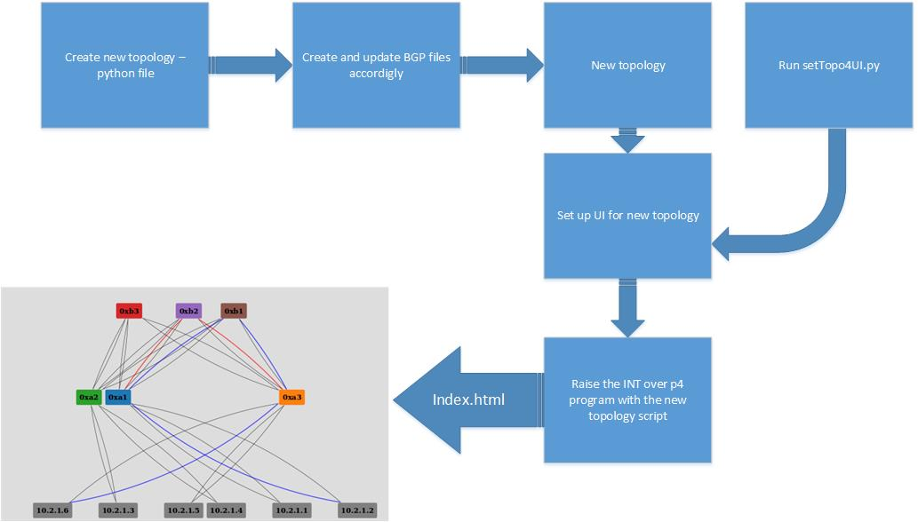
System workflow

Slide 7
Analyzing and Changing topology script
README Python file: defaultTopo_with_structural_analysis(README).py
Let’s analyze how topology file should look like.
By learning this we can understand how to set the topology we would like.

Slide 8
Analyzing and Changing topology script
Python defaultTopo_with_structural_analysis(README).py –h:
1) for initial the INT over p4 program run the script as follows: (e.g.) sudo some_topology.py --model-dir=$INSTALL_DIR.
2) for changing the topology read the file comments, after change the topology and config the bgp as well you can set up the UI, BEFORE you run the program as describe in 1, by running setTopo4UI.py script on your topology file.

Slide 9
Analyzing and Changing topology script
Python defaultTopo_with_structural_analysis(README).py –h:
NOTES for topology change:
a) pay attention to white spaces - they are built according to a certain legality in the script : setTopo4UI.py - for updating the UI topology.
b) for each topology change the BGP configuration files, for each switch, must change accordingly.
c) model_dir - installations dir. d) for changing the topology change sections 1 and 2 in defaultTopo_with_structural_analysis(README).py under the regulations.
e) for change the system packet flow - change section 3 in defaultTopo_with_structural_analysis(README).py .
f) for linking switch and host you can see also Https://github.com/p4lang/p4factory/blob/master/mininet/int_cfg.py - configHostRoutesAndArp - line 227.

Slide 10
Analyzing and Changing topology script
def run_cfg(model_dir)
defaultTopo_with_structural_analysis(README).py
This is the class configuration for the INT over p4 program that her installation guide can be found in https://lccn-cs.atlassian.net/wiki/display/KB/How-to+articles (permissions are necessary).
the topology described below is the default one.

Slide 11
Analyzing and Changing topology script
def run_cfg(model_dir)
vxlan and hosts definition
configure vxlan for hosts:
h1_vxlan_cfg = VxlanConfig( vxlan_id, vxlan_group, '10.2.1.1', 24, '00:11:22:33:44:51', vxlan_mtu )
h2_vxlan_cfg = VxlanConfig( vxlan_id, vxlan_group, '10.2.1.2', 24, '00:11:22:33:44:52', vxlan_mtu )
h3_vxlan_cfg = VxlanConfig( vxlan_id, vxlan_group, '10.2.1.3', 24, '00:11:22:33:44:53', vxlan_mtu )
h4_vxlan_cfg = VxlanConfig( vxlan_id, vxlan_group, '10.2.1.4', 24, '00:11:22:33:44:54', vxlan_mtu )
default vxlan settings
vxlan_id = 10
vxlan_group = '239.0.0.10'
vxlan_mtu = 1300

Slide 12
Analyzing and Changing topology script
def run_cfg(model_dir)
vxlan and hosts definition
config hosts and set up the vxlan_cfg for each host
e.g. for host h1 the vxlan_cfg get h1_vxlan_cfg that defined above
host_cfgs = {
'h1' : HostConfig( name = 'h1', mac = '00:c0:a0:a0:00:01', ip = '10.0.1.1', prefix_len = 24, vxlan_cfg = h1_vxlan_cfg ),
'h2' : HostConfig( name = 'h2', mac = '00:c0:a0:a0:00:02', ip = '10.0.2.2', prefix_len = 24, vxlan_cfg = h2_vxlan_cfg ),
'h3' : HostConfig( name = 'h3', mac = '00:c0:a0:a0:00:03', ip = '10.0.3.3', prefix_len = 24, vxlan_cfg = h3_vxlan_cfg ),
'h4' : HostConfig( name = 'h4', mac = '00:c0:a0:a0:00:04', ip = '10.0.4.4', prefix_len = 24, vxlan_cfg = h4_vxlan_cfg )
}

Slide 13
Analyzing and Changing topology script
def run_cfg(model_dir)
linking and nodes definition
configure each switch ports for hosts
NOTE: The operation that including this ports will described next
leaf1 ports for hosts h1 and h2
leaf1_port_cfgs = [
PortConfig( port_no = 0, ip = '10.0.1.100', prefix_len = 24, mac = '00:01:00:00:00:01' ),
PortConfig( port_no = 1, ip = '10.0.2.100', prefix_len = 24, mac = '00:01:00:00:00:02' ),
]
leaf2 ports for hosts h3 and h4
leaf2_port_cfgs = [
PortConfig( port_no = 0, ip = '10.0.3.100', prefix_len = 24, mac = '00:02:00:00:00:01' ),
PortConfig( port_no = 1, ip = '10.0.4.100', prefix_len = 24, mac = '00:02:00:00:00:02' ),
]

Slide 14
Analyzing and Changing topology script
def run_cfg(model_dir)
linking and nodes definition
switch configs
E.g. leaf1
switch_cfgs = [
SwitchConfig( name = 'leaf1',
port_cfgs = leaf1_port_cfgs,
swapi_port = 26000,
bmcli_port = 27000,
config_fs = 'configs/leaf1/l3_int_ref_topo',
model_dir = model_dir,
switch_id = 0x000000A1, pps=400, qdepth=15 ),
…]

Slide 15
Analyzing and Changing topology script
def run_cfg(model_dir)
linking and nodes definition
switch configs
note the topology orgenized the switches as leafs and spines
a) name - name of the switch
b) port_cfgs - ports for hosts as describe (will be described soon)
c) swapi_port - api port - note that the ports are different for each switch
d) bmcli_port - cli port - note that the ports are different for each switch

Slide 16
Analyzing and Changing topology script
def run_cfg(model_dir)
linking and nodes definition
switch configs
e) config_fs - path for BGP configuration - NOTE:
FOR EACH TOPOLOGY CHANGE THE BGP CONFIGURATION FILES, FOR EACH SWITCH, MUST CHANGE ACCORDINGLY(example will be shown)
you should change ,e.g. for leaf 1 :
https://github.com/p4lang/p4factory/blob/master/mininet/configs/leaf1/l3_int_ref_topo/startup_config.sh
https://github.com/p4lang/p4factory/blob/master/mininet/configs/leaf1/l3_int_ref_topo/quagga/bgpd.conf

Slide 17
1.1 analyzing topology file
1.1.2 def run_cfg(model_dir)
linking and nodes definition
switch configs
f) model_dir - the model dir which the class generate.
g) switch_id - the value of the id increase for each switch. leafs(A) and spine(B) separately.
NOTE: switch_id value is an hex number(0x...).

Slide 18
1.1 analyzing topology file
1.1.2 def run_cfg(model_dir)
linking and nodes definition
link configs
for linking switch and host you should note only the switch port number (will be described soon)
for linking 2 switches note for each the designated port(index) for the connection

Slide 19
1.1 analyzing topology file
1.1.2 def run_cfg(model_dir)
linking and nodes definition
link configs
link_cfgs = [
LinkConfig( 'leaf1', 'h1', 0 ),
LinkConfig( 'leaf1', 'h2', 1 ),
LinkConfig( 'leaf1', 'spine1', 2, 0 ),
LinkConfig( 'leaf1', 'spine2', 3, 0 ),
…]

Slide 20
1.1 analyzing topology file
1.1.2 def run_cfg(model_dir)
linking and nodes definition
Let’s look at int_cfg.py line 227:
def configHostRoutesAndArp(self):
for l in self.link_cfgs:
if l.port2 == None:
sw = self.switch_cfgs[l.node1]
h = self.net.get(l.node2)
port = sw.port_cfgs[l.port1]
h.cmd("route add default gw %s" % port.ip)

Slide 21
1.1 analyzing topology file
1.1.2 def run_cfg(model_dir)
linking and nodes definition
def configHostRoutesAndArp(self):
Actually looks for LinkConfig( node1, node2, port1 ) in link_cfgs and if so:
Generate the switch_cfgs of node1 → which mean node1 needs to mention switch, and look for the port in index port1 → port = self.switch_cfgs[node1].port_cfgs[port1]

Slide 22
1.2 example
We would like to add a switch to the topology, leaf3, and 2 hosts, h5 and h6.
Let’s see the code we should add.

Slide 23
1.2 example
h5 and h6:
Configure vxlan
h5_vxlan_cfg = VxlanConfig( vxlan_id, vxlan_group, '10.2.1.5', 24, '00:11:22:33:44:55', vxlan_mtu )
h6_vxlan_cfg = VxlanConfig( vxlan_id, vxlan_group, '10.2.1.6', 24, '00:11:22:33:44:56', vxlan_mtu )

Slide 24
1.2 example
h5 and h6:
Add to host_cfgs
host_cfgs = {…
'h5' : HostConfig( name = 'h5', mac = '00:c0:a0:a0:00:05', ip = '10.0.5.5', prefix_len = 24, vxlan_cfg = h5_vxlan_cfg ),
'h6' : HostConfig( name = 'h6', mac = '00:c0:a0:a0:00:06', ip = '10.0.6.6', prefix_len = 24, vxlan_cfg = h6_vxlan_cfg ),
}

Slide 25
1.2 example
leaf3:
Port configure for h5 and h6
leaf3_port_cfgs = [
PortConfig( port_no = 0, ip = '10.0.5.100', prefix_len = 24, mac = '00:05:00:00:00:01' ),
PortConfig( port_no = 1, ip = '10.0.6.100', prefix_len = 24, mac = '00:05:00:00:00:02' ),
]

Slide 26
1.2 example
leaf3:
add the switch to switch_cfgs
switch_cfgs = […
SwitchConfig( name = 'leaf3',
port_cfgs = leaf3_port_cfgs,
swapi_port = 26004,
bmcli_port = 27004,
config_fs = 'configs/leaf3/l3_int_ref_topo',
model_dir = model_dir,
switch_id = 0x000000A3, pps=400, qdepth=15 ),
…]
NOTE: Config_fs explained soon.

Slide 27
1.2 example
leaf3:
adding the linking
link_cfgs = […
LinkConfig( 'leaf3', 'h5', 0 ),
LinkConfig( 'leaf3', 'h6', 1 ),
LinkConfig( 'leaf3', 'spine1', 2, 2 ),
LinkConfig( 'leaf3', 'spine2', 3, 2 ),

Slide 28
1.2 example
Now, after we change the topology file we should update the quagga and BGP accordingly.
Why BGP update?
-proper routing
-see the flow in the UI.

Slide 29
1.2 example
Leaf3 startup_config.sh:
#!/bin/bashstty
-echo; set +m
#Setting ports
ip link set dev swp1 address 00:05:00:00:00:01
ip link set dev swp2 address 00:05:00:00:00:02
ip link set dev swp3 address 00:05:00:00:00:03
ip link set dev swp4 address 00:05:00:00:00:04
#Adding ip address
ip address add 10.0.5.100/24 broadcast + dev swp1
ip address add 10.0.6.100/24 broadcast + dev swp2
ip address add 10.1.31.1/24 broadcast + dev swp3
ip address add 10.1.32.1/24 broadcast + dev swp4
cp /configs/quagga/* /etc/quagga/
chown quagga.quagga /etc/quagga/*

Slide 30
1.2 example
Leaf3 bgpd.conf:
hostname bgpd
password zebra
enable password zebra
log file /var/log/quagga/bgpd.log
#AS name of the switch and the declares networks of BGP for listed neighbors
router bgp 64103
bgp router-id 10.0.5.100
network 0.0.0.0/0
network 10.0.5.0/24
network 10.0.6.0/24
network 10.1.31.0/24
network 10.1.32.0/24
neighbor 10.1.31.2 remote-as 64200
neighbor 10.1.31.2 timers 1 3
neighbor 10.1.32.2 remote-as 64200
neighbor 10.1.32.2 timers 1 3
maximum-paths 16
access-list all permit any

Slide 31
1.2 example
Spine1 startup_config.sh add:
#Setting ports
ip link set dev swp3 address 00:03:00:00:00:03
#Adding ip address
ip address add 10.1.31.2/24 broadcast + dev swp3
cp /configs/quagga/* /etc/quagga/
chown quagga.quagga /etc/quagga/*

Slide 32
1.2 example
Spine2 startup_config.sh add:
#Setting ports
ip link set dev swp3 address 00:04:00:00:00:03
#Adding ip address
ip address add 10.1.32.2/24 broadcast + dev swp3
cp /configs/quagga/* /etc/quagga/
chown quagga.quagga /etc/quagga/*

Slide 33
1.2 example
Spine1 bgp.conf add:
#Adding networks
network 10.1.31.0/24
#Adding neighbors
neighbor 10.1.31.1 remote-as 64103
neighbor 10.1.31.1 timers 1 3

Slide 34
1.2 example
Spine2 bgp.conf add:
#Adding networks
network 10.1.32.0/24
#Adding neighbors
neighbor 10.1.32.1 remote-as 64103
neighbor 10.1.32.1 timers 1 3

Slide 35
1.2 example
After all this additions, according to our additions in the topology file, we successfully can raise the new INT over p4 program with the new topology.

Slide 36
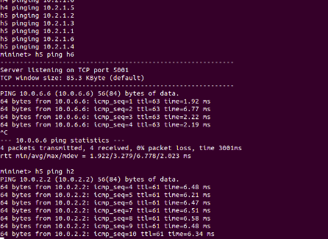
1.2 example – h5 ping h2

Slide 37
2. Setting UI
Now, after we succeeded changing topology we would like to change the UI also → which means, after running the program, as it promised from the system, the index.html file should show the topology and some details of the net. We would like it to show our new topology.

Slide 38
2. Setting UI
For this purpose we create the script setTopo4UI.py, which you should run on your topology script after you changed it and before you run the system with it.

Slide 39
2. Setting UI
setTopo4UI.py
python setTopo4UI.py –h:
setting the UI declaration based on input file that should be found in INT over p4 directory path/p4factory/mininet/some_topology.py (e.g.).
a) for changing the topology read the defaultTopo_with_structural_analysis(README).py .
b) after change the topology(hosts, nodes, linking and BGP configurations) you should run this script on your topology file(note: this is the file you should run after you set up the INT over p4 program) for changing the UI topology that can be found in https://github.com/p4lang/p4factory/blob/master/apps/int/monitor/client/index.html .
c) for the INT over p4 - installation guide can be found in https://lccn-cs.atlassian.net/wiki/display/KB/How-to+articles (permissions are necessary).

Slide 40
2. Setting UI
setTopo4UI.py run
python setTopo4UI.py –f input_topology.py
This script will change the relevant json file and allows the index.html file to show the new topology after raise the INT over p4 new program.

Slide 41
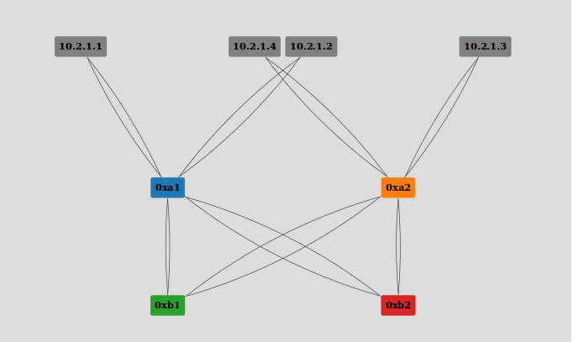
2. Setting UI
Index.html topology before:

Slide 42
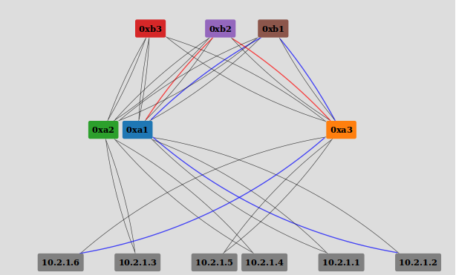
2. Setting UI
Index.html topology after + route flow from h6 to h2:

Slide 43
3. Optional future development
On the fly upgrading:
Adding nodes to the net when it runs.
Detecting the topology of the net by itself – no need for pre running definitions of the topology for the UI – the UI should be able to analyzed the net data with the INT properties by it self and show it inline(support for changes).
If so this tool could be useful in many sites.

